Slide 1


REAL ESTATE MANAGEMENT SYSTEM

Slide 2
Contents
Problem Statement
Business Requirement
Web UI and Design of Real Estate Application
Tools and Technologies
Conclusion

Slide 3
Batch- 99 Team- B
Chaitali Samudre
UI Design
MySQL Developer
Shwetha Nagesh
UI Design
Java Developer
Shubhangi Kittur
UI Design
Java Developer
Nisarga Gowda
UI Design
MySQL Developer
Priya P Shetty
UI Design
Java Developer

Slide 4
Problem Statement
The main objective of the Online Real Estate Management System is to manage the details of Sellers, Property, Registrations, Property Type.
Online real estate system is a friendly format for buying and selling properties. Users can search and browse for property in this application.
This application mainly concentrates on maintaining and managing the details of the property.
This System provides a superior real-estate experience by making it easier, faster, secure and more accurate to find buyers for your valuable property.

Slide 5

Business Requirement
The application have the login and register option for admin and seller.
To manage the details of sellers, buyer list, property creation and property type.
To allow users to search property and to buy, rent or lease.
Allows the seller to sell the property, house on rent or lease.

Slide 6
Design of Real Estate Application
Controller(Accepts the user details and transfer the request to database
Buyer view
Seller view
Admin View
Server
User
Front-end
Database Model
( responds to server queries)
Backend

Slide 7
Web UI
Real Estate Management
Home Page
Buyer
Register
Login
Property List
Seller
Admin
Buy Property
Create Property
Property List
Buyer List
Buyer List
Buyer Information
Logout
Seller List

Slide 8
TOOLS AND TECHNOLOGIES
Spring Boot MVC
CSS
HTML
MAVEN
JavaScript(JSP)
JAVA
MYSQL WORKBENCH
Spring tool suite-4.13.1
Bootstrap
Hibernate

Slide 9
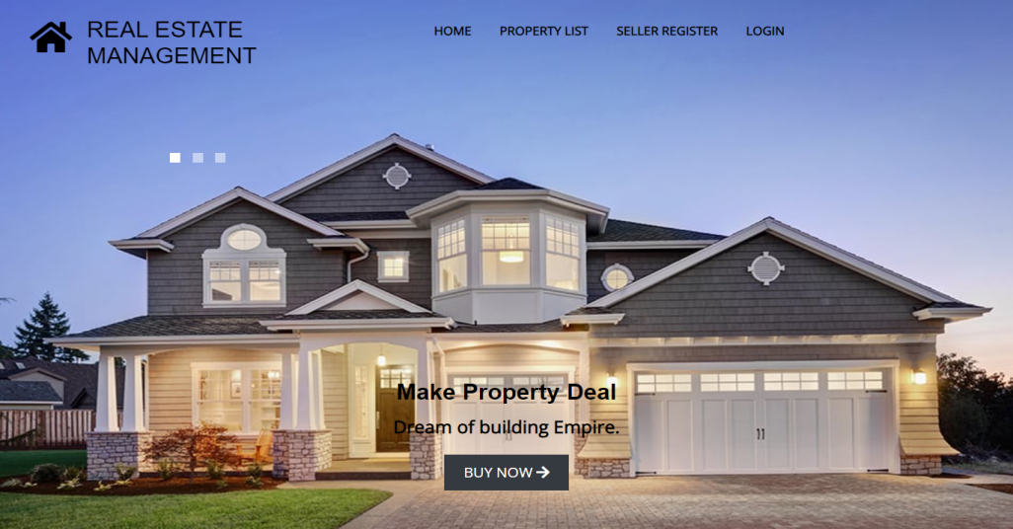
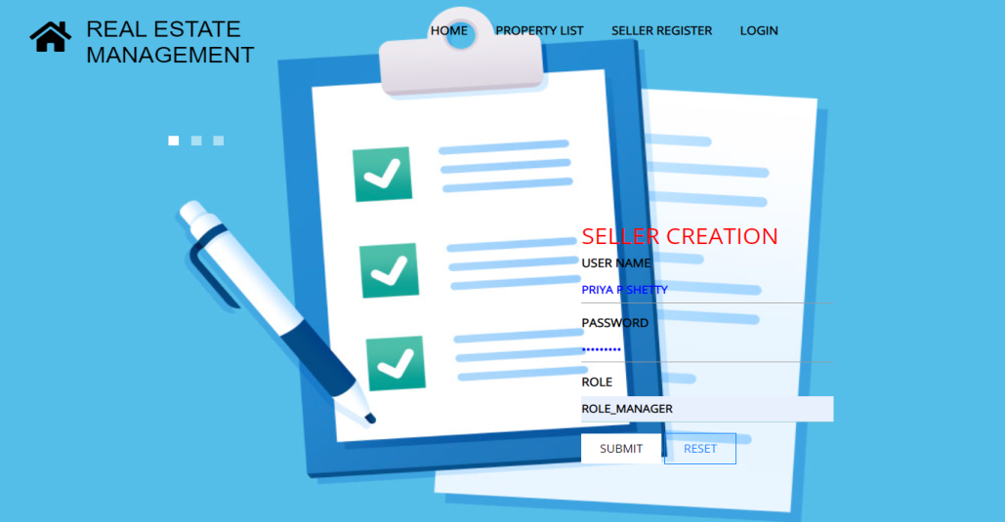
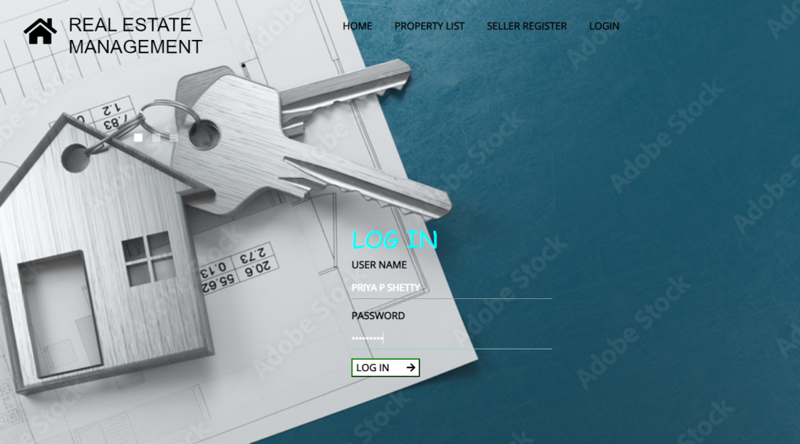
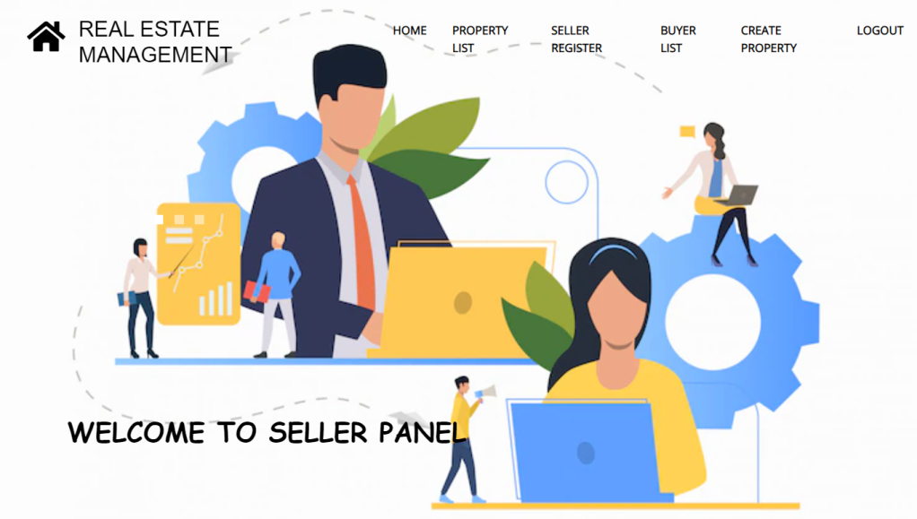
Screenshot
Home Page and Seller Module

Slide 10
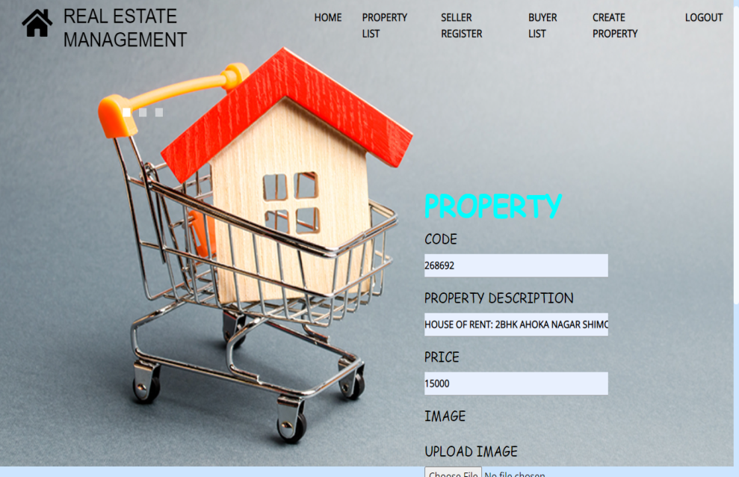
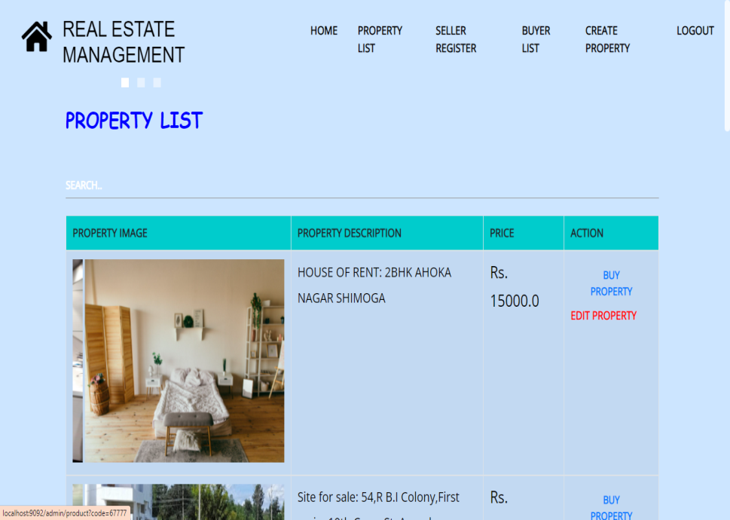

Slide 11
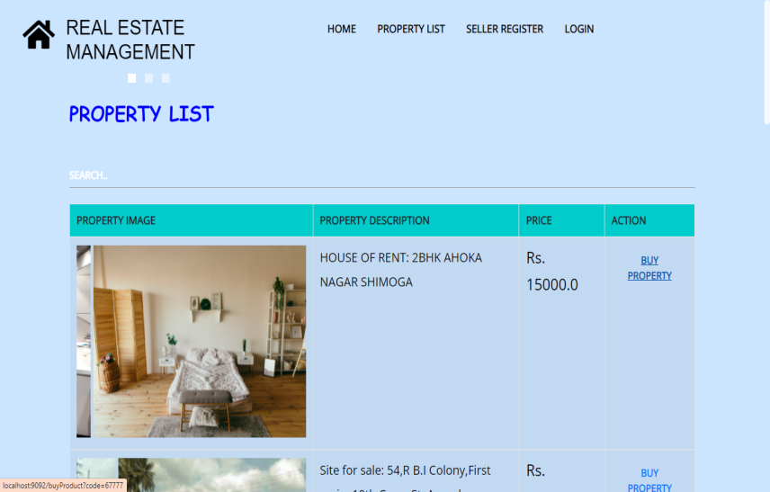
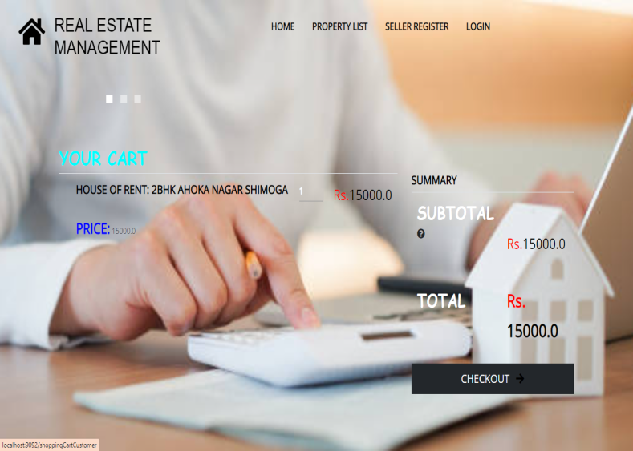
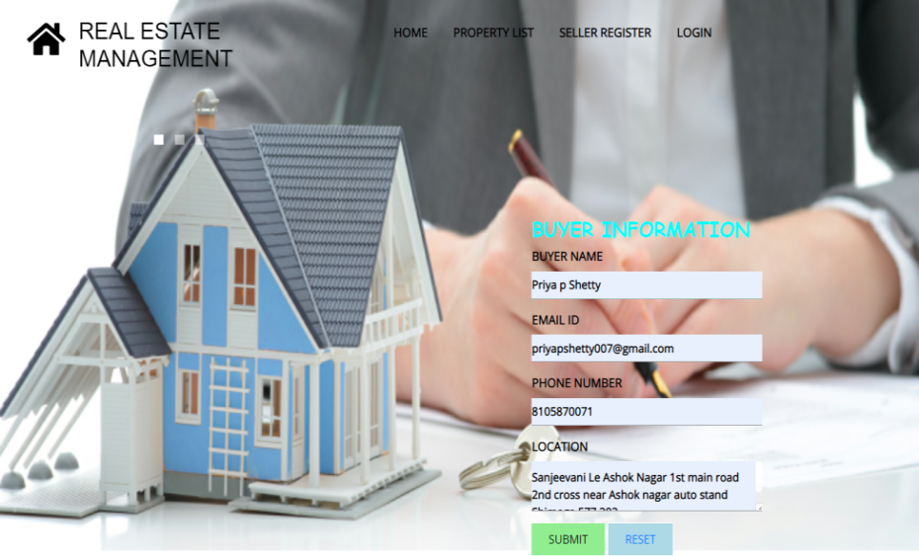
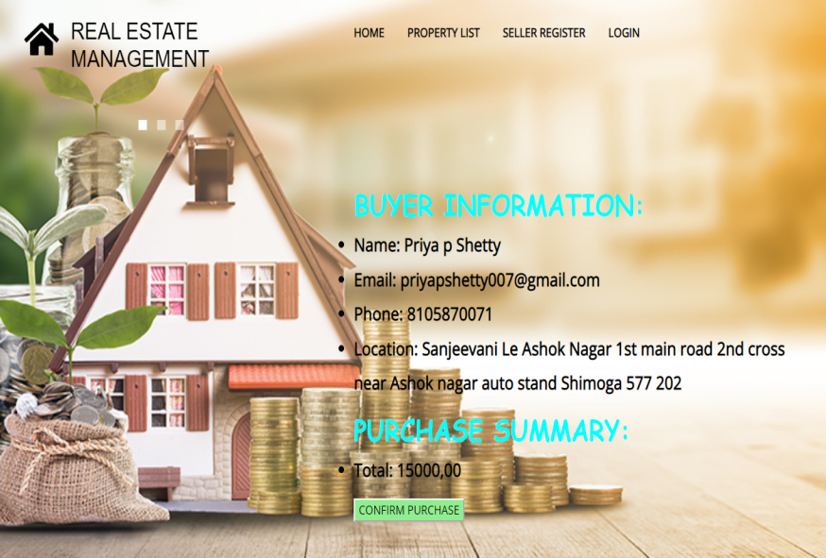
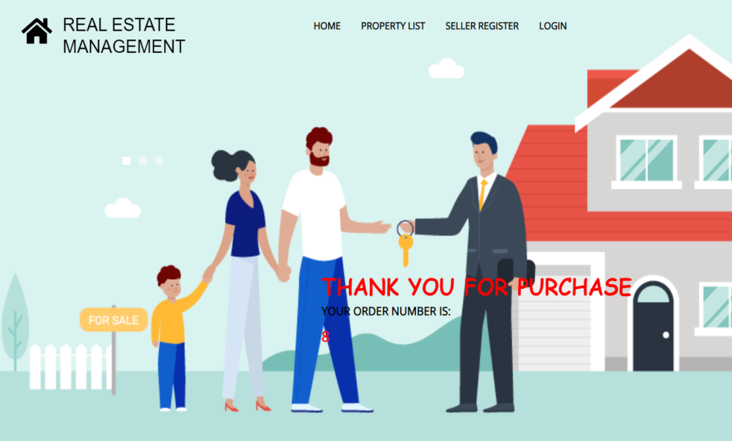
Buyer Module

Slide 12
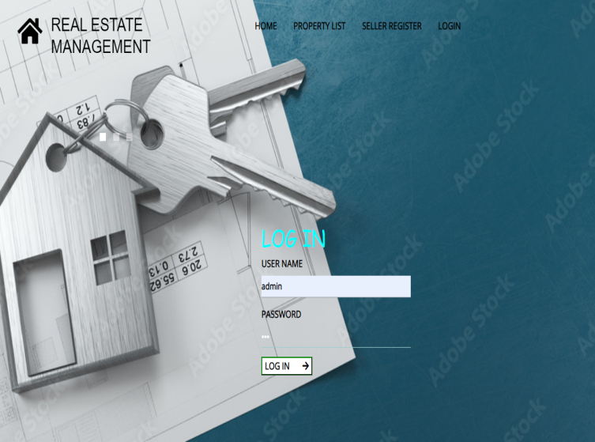
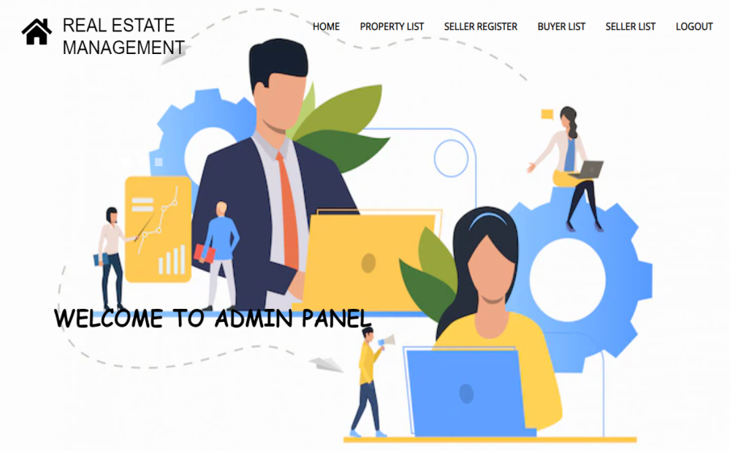
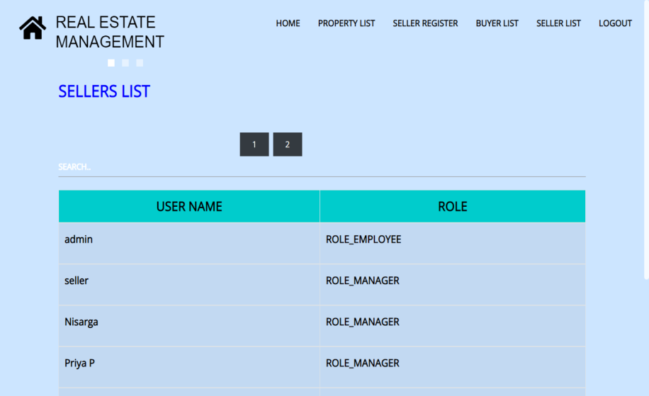
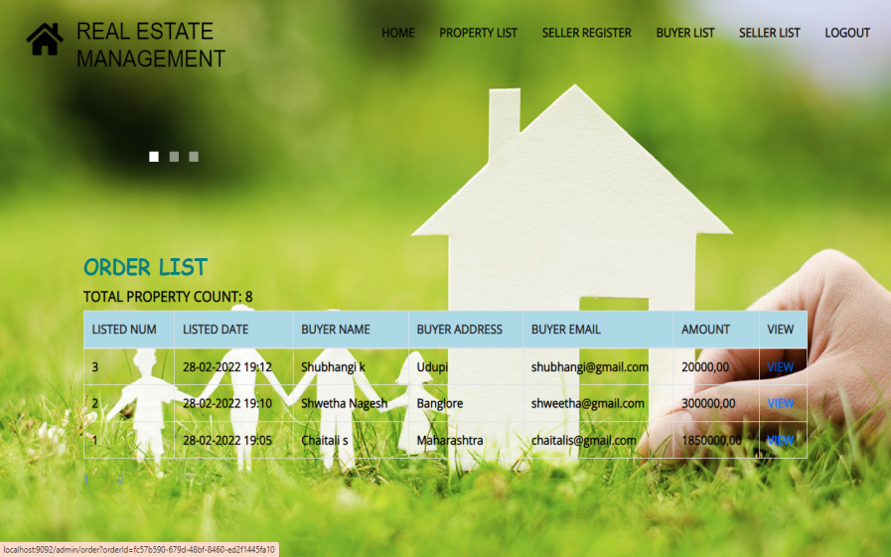
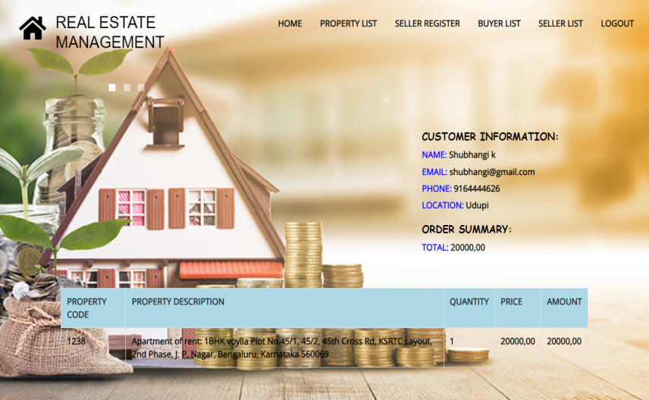
Admin Module

Slide 13
CONCLUSION
The main purpose of real estate management system is to resolve the issue of both buyer and seller by providing the user friendly application to use.
This avoids unauthorized users from accessing the application.
Helps to find the desired property easily.

Slide 14

THANK YOU

